Slide 1
API Security
.NET Development

Slide 2
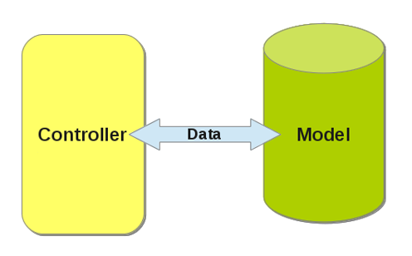

Single Page Applications
Request
Data
API

Slide 3
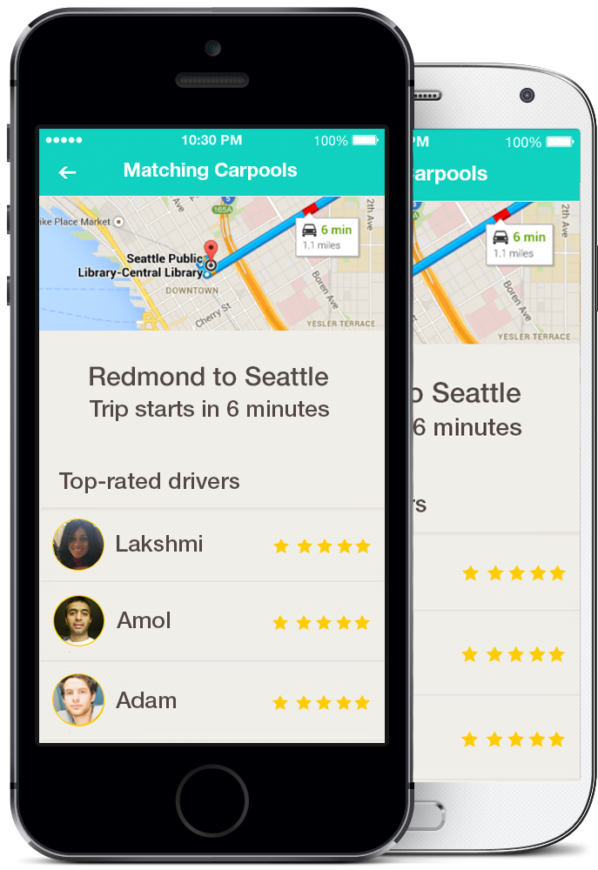

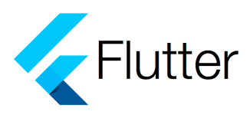
Mobile applications
Request
Data
API

Slide 4
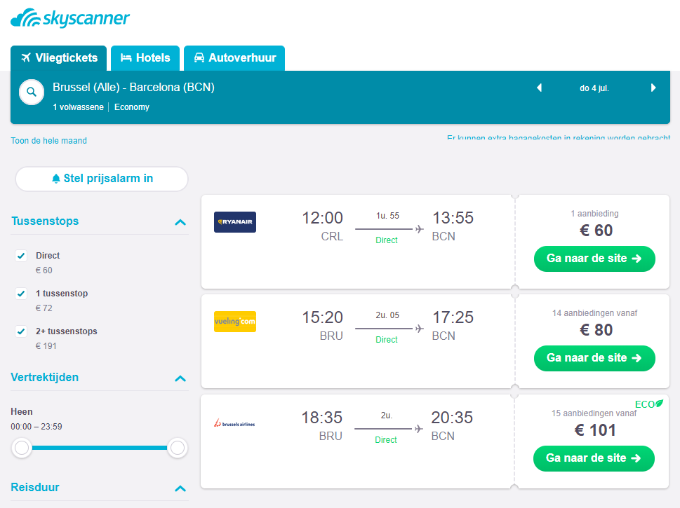
Communication between applications
Request
Data
API

Slide 5
Why security?
Only authenticated users of our application can make calls to the API
We want to know the user who makes the call so we can prevent the user accessing data from other users

Slide 6
What type of security?
Bearer authentication is also called token authentication.
Bearer in dutch: “drager”, “houder”
Bearer authentication gives access to the bearer of the token
The bearer token is a cryptic string, usually generated by the server in response to a login request. The client must send this token in the Authorization header when making requests to protected resources:
Authorization: Bearer
Notes:
Basic authentication means passing encrypted username/password string over https

Slide 7

Security flow
HTTP POST
Body: username/password
/api/user/authenticate (not secured)
/api/products (secured)
Token
Token
List of products
Notes:
Authentication means that a user has provided credentials which the system has accepted. This is often a username and password, but could be a code from a magic link, a token from a social auth provider, or a JWT (Jason Web Token) from an external identity provider.

Slide 8
What type of security?
JWT => JSON Web Token
JSON based access token
Consists of 3 parts: xxxxx.yyyyy.zzzzz
Header (signing algorythm + type of token:JWT)
Payload (claims: userID, username, roles, permissions, …)
Signature calculation based on secret, header & payload
https://jwt.io/
https://en.wikipedia.org/wiki/JSON_Web_Token
https://dzone.com/articles/jwt-token-lightweight-token-based-authentication
Notes:
JWTs can be signed using a secret (with the HMAC algorithm) or a public/private key pair using RSA or ECDSA.
Here we demonstrate JWT with a signed secret

Slide 9
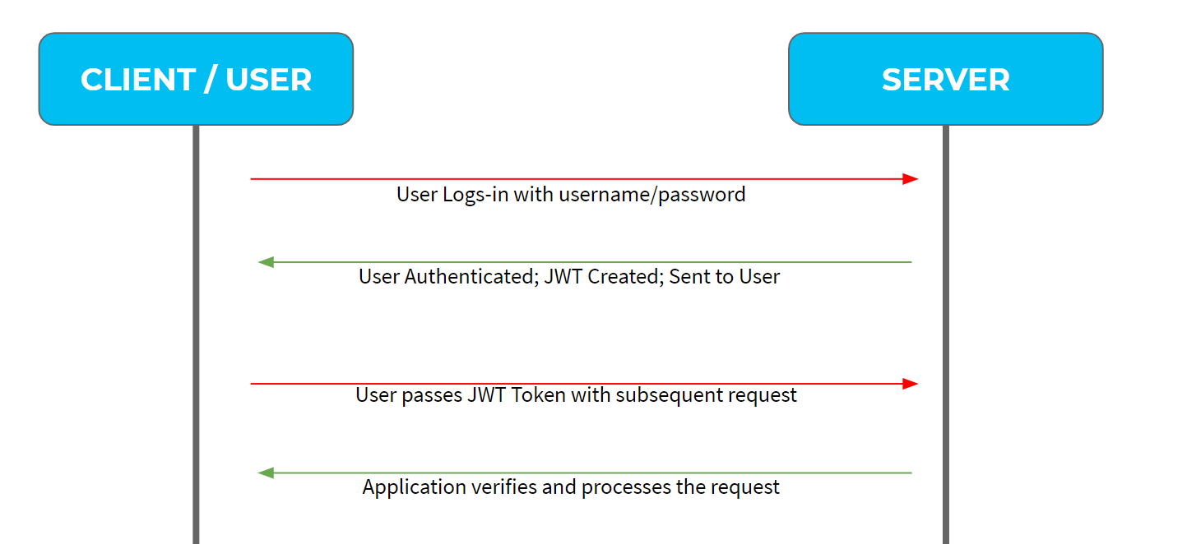
Security flow

Slide 10
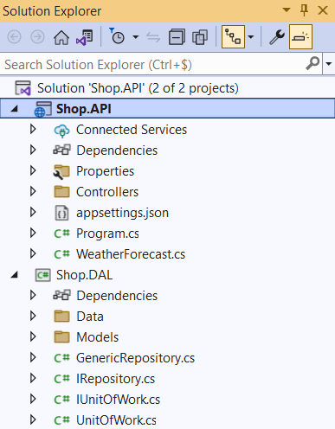
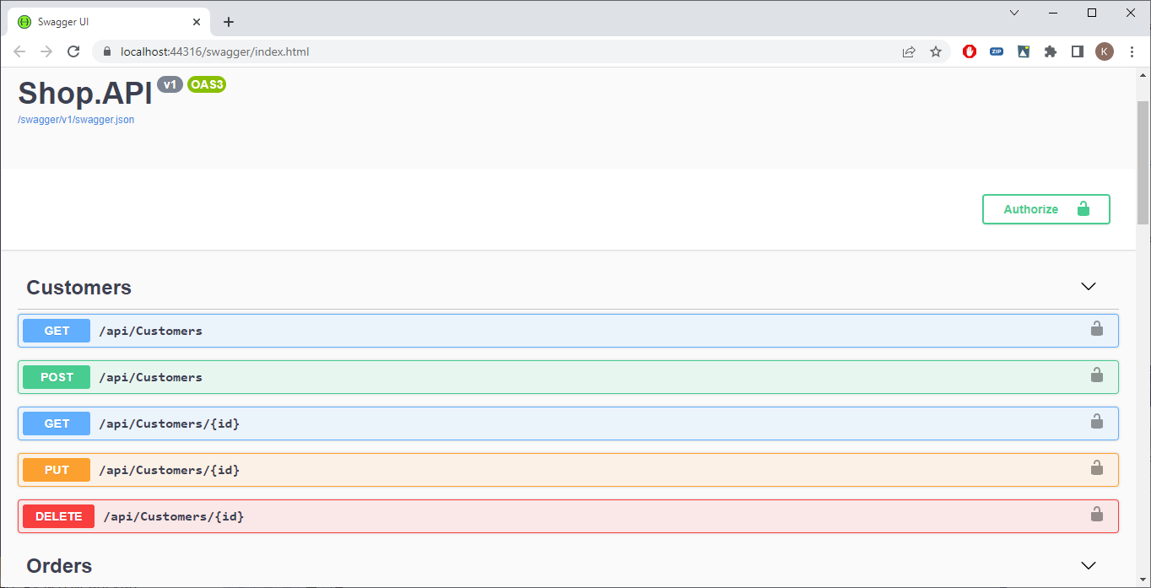
Implementation
Not difficult, but a lot of configuration
Open your Shop.API solution
Start

Slide 11
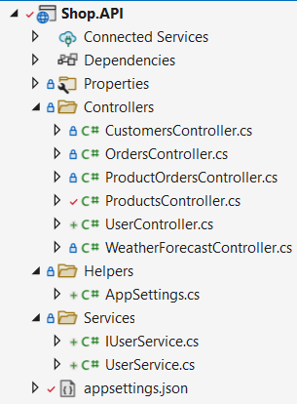
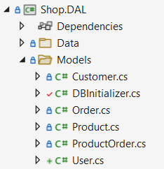
Configuration (Step by step in the next slides)
Models
User ( 1 – 1 relationship with Customer)
Controllers
UserController (Authenticate-method)
Services
IUserService
UserService (Authenticate)
Helpers
AppSettings

Slide 12
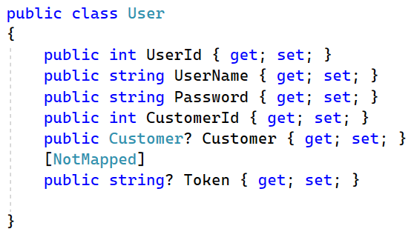
Models – User.cs (~resources)
User class will be a table in the database
CustomerId: relationship with Customer
Token: used for passing the generated JWT token
[NotMapped]: token field shouldn’t be a column in the table User – we don’t want to store the token in the database
Notes:
using System.ComponentModel.DataAnnotations.Schema;

Slide 13
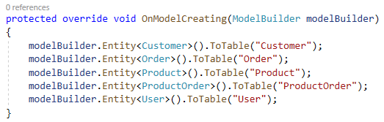
Extend the ShopContext
Add a DbSet for the Users
Make sure the User table is named correctly
public DbSet<User> Users { get; set; }

Slide 14
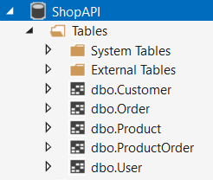
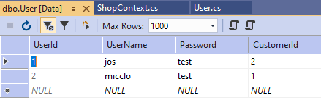
Extend the DBInitializer
context.AddRange( new User { UserName="micclo", Password="test", CustomerId = 1 },
new User { UserName= "jos", Password = "test", CustomerId = 2 });
context.SaveChanges();
Delete your current SHOPAPI database!
Run your application to recreate the database.
Better?
Notes:
Better solution is to use migrations

Slide 15
appsettings.json
We need a private key that is used to sign our JWT tokens
Create a new AppSettings config section in appsettings.json from API
"AppSettings": { "Secret": "ILHGIUBIOY768T7IGUBK¨M¨¨^ùlJH7T61F" }, "ConnectionStrings": { "DefaultConnection": "Data Source=(localdb)\\MSSQLLocalDB;Initial Catalog=ShopAPI;Integrated Security=True;Connect Timeout=30;Encrypt=False;TrustServerCertificate=False;ApplicationIntent=ReadWrite;MultiSubnetFailover=False" },

Slide 16
Secret
The secret is just a randomly chosen string.
The string is used to sign the JWT token with the HMAC algorithm.
It’s important to use a long, random secret (at least 16 characters) when you are using a symmetric algorithm. Don’t choose a key that is in use in any other system.
Longer keys or secrets are more secure but take longer to generate signatures.

Slide 17
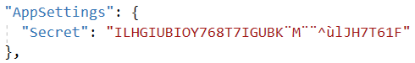
Helpers – AppSettings (in Shop.API)
Create a new ‘Helpers’ folder with a class ‘AppSettings’
This class will allow us to work with strongly typed settings out of appsettings.json
public class AppSettings { public string Secret { get; set; } }

Slide 18
Program.cs
Add after AddSwaggerGen();
Later, we can inject the AppSettings class in our UserService so we can access our Secret there (= DI)
var appSettingsSection = builder.Configuration.GetSection("AppSettings"); builder.Services.Configure<AppSettings>(appSettingsSection);
public class AppSettings { public string Secret { get; set; } }

Slide 19
(I)UserService (in Shop.API)
Authentication takes place here
Checks if a user with username and password exists
Generates a token
Returns authenticated user and token
Add a new folder ‘Services’
new interface ‘IUserService’
new class ‘UserService’
What will be in our Interface? Method? Parameters? Return type?

Slide 20
IUserService (~resources)
public interface IUserService { User Authenticate(string username, string password); }

Slide 21
Userservice (~resources)
public class UserService : IUserService { private readonly AppSettings _appSettings; private readonly shopContext _shopContext; public UserService(IOptions<AppSettings> appSettings, ShopContext shopContext) { _appSettings = appSettings.Value; _shopContext = shopContext; } public User Authenticate(string username, string password) { var user = _shopContext.Users.Include(u => u.Customer).SingleOrDefault(x => x.UserName == username && x.Password == password); // return null if user not found if (user == null) return null; // authentication successful so generate jwt token var tokenHandler = new JwtSecurityTokenHandler(); var key = Encoding.ASCII.GetBytes(_appSettings.Secret); var tokenDescriptor = new SecurityTokenDescriptor {
Subject = new ClaimsIdentity(new Claim[] { new Claim("UserId", user.UserId.ToString()), new Claim("Email", user.Customer.Email), new Claim("Username", user.UserName) }), Expires = DateTime.UtcNow.AddDays(7), SigningCredentials = new SigningCredentials(…) }; var token = tokenHandler.CreateToken(tokenDescriptor); user.Token = tokenHandler.WriteToken(token); // remove password before returning user.Password = null; return user; } }
Notes:
using Microsoft.Extensions.Options;
using Microsoft.IdentityModel.Tokens;
using System.IdentityModel.Tokens.Jwt;
using System.Security.Claims;
using System.Text;

Slide 22
UserController (~resources)
API Controller that hosts the POST method Authenticate
[Route("api/[controller]")] public class UserController : ControllerBase { private IUserService _userService; public UserController(IUserService userService) { _userService = userService; } [HttpPost("authenticate")] public IActionResult Authenticate([FromBody]User userParam) { var user = _userService.Authenticate(userParam.UserName, userParam.Password); if (user == null) return BadRequest(new { message = "Username or password is incorrect" }); return Ok(user); } }

Slide 23
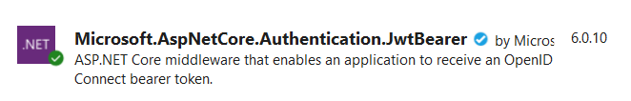
Install nuget package
Use version 6.0.10
Notes:
Library with classes for JWT bearer authentication.

Slide 24
Program.cs - ConfigureServices() (~resources)
After appSettingsSection
// configure jwt authentication
var appSettings = appSettingsSection.Get<AppSettings>();
var key = Encoding.ASCII.GetBytes(appSettings.Secret);
builder.Services.AddAuthentication(x =>
{
x.DefaultAuthenticateScheme = JwtBearerDefaults.AuthenticationScheme;
x.DefaultChallengeScheme = JwtBearerDefaults.AuthenticationScheme;
})
.AddJwtBearer(x =>
{
x.RequireHttpsMetadata = false;
x.SaveToken = true;
x.TokenValidationParameters = new TokenValidationParameters
{
ValidateIssuerSigningKey = true,
IssuerSigningKey = new SymmetricSecurityKey(key),
ValidateIssuer = false,
ValidateAudience = false
};
});
// configure DI for application services
builder.Services.AddScoped<IUserService, UserService>();
Notes:
using Microsoft.AspNetCore.Authentication.JwtBearer;
using System.Text;
using Microsoft.IdentityModel.Tokens;

Slide 25
Startup.cs – Configure()
A user must first be authenticated before being authorized.
Add before app.UseAuthorization()
app.UseAuthentication();

Slide 26
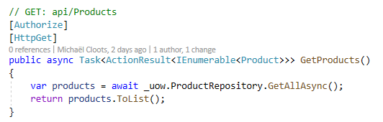
ProductScontroller
Add the [Authorize] attribute to oblige authentication and authorization for controller or method(s) => same as in ASP.NET MVC
Authorize GetProducts() method
Notes:
using Microsoft.AspNetCore.Authorization;

Slide 27
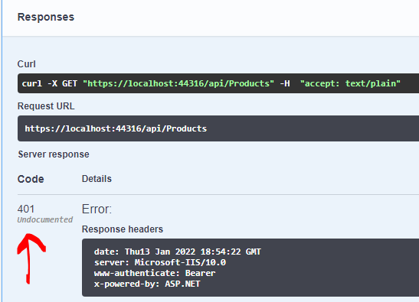
Try to get products
Error 401! The request fails because the token was not set in the request header.

Slide 28
Swagger (~resources)
Extend swagger so we can set the JWT token in the request header, replace previous services.AddSwaggerGen
builder.Services.AddSwaggerGen(c =>
{
c.AddSecurityDefinition("Bearer", new OpenApiSecurityScheme()
{
Name = "Authorization",
Type = SecuritySchemeType.ApiKey,
Scheme = "Bearer",
BearerFormat = "JWT",
In = ParameterLocation.Header,
Description = "JWT Authorization header using the Bearer scheme. \r\n\r\n Enter 'Bearer' [space] and then your token in the text input below.\r\n\r\nExample: \"Bearer 12345abcdef\"",
});
c.AddSecurityRequirement(new OpenApiSecurityRequirement {
{new OpenApiSecurityScheme {Reference = new OpenApiReference {Type = ReferenceType.SecurityScheme, Id = "Bearer" } }, new string[] {}}
});
c.SwaggerDoc("v1", new OpenApiInfo { Title = "Shop.API", Version = "v1" });
});
Notes:
using Microsoft.OpenApi.Models;

Slide 29
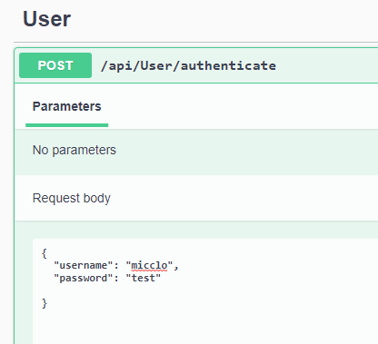
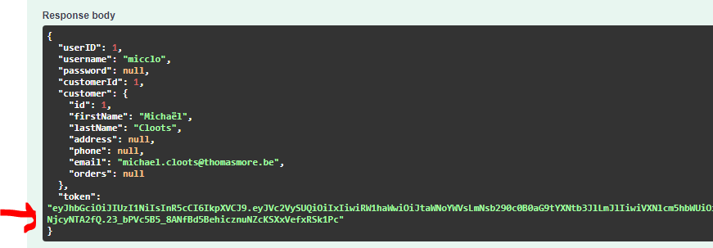
Login to get token
First run User/Authenticate to receive a token

Slide 30
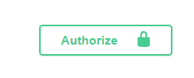
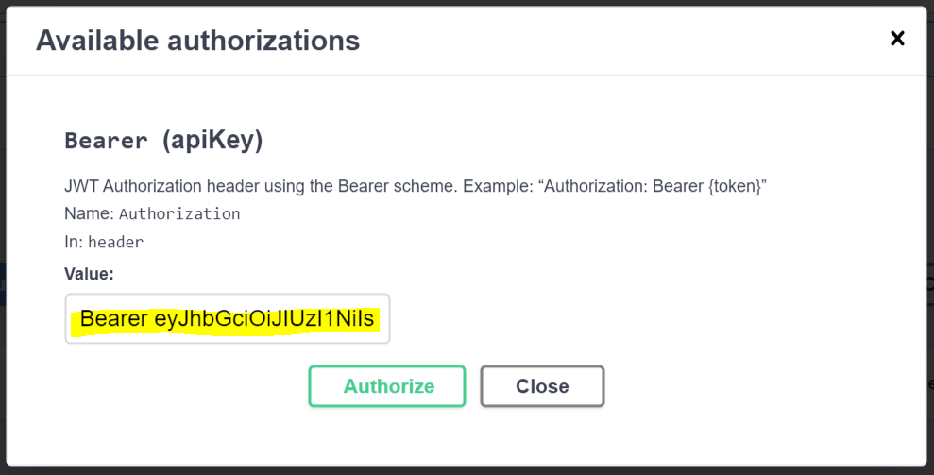
Authorize in swagger to pass token
The value should be ‘Bearer ‘ + the JWT token!

Slide 31
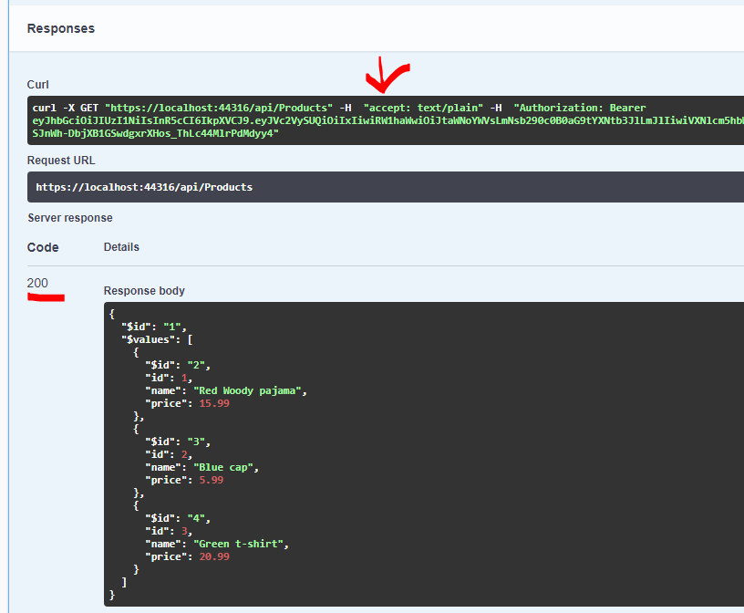
Try again
Run Get Products
Token is passed to the request
Request succeeds!
3 products are returned

Slide 32
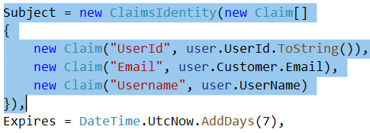
Getting the claims
We added some claims to our token (UserService)
UserID
Email
Username
Access them like this
[Authorize] [HttpGet] public async Task<ActionResult<IEnumerable<Product>>> GetProducts() { var userID = User.Claims.FirstOrDefault(c => c.Type == "UserId").Value; return await _context.Products.ToListAsync(); }

Slide 33
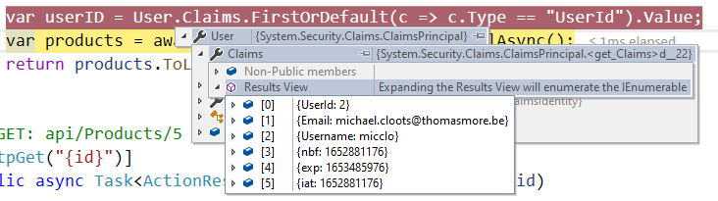
Getting the claims
Set a break in order to check the information in the token.
Start the api with debugging (F5)

Slide 34
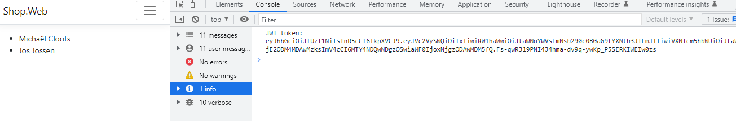
Consuming the secured api in Shop.web project
In the previous chapter we added a Shop.web project and made changes to index.cshtml in order to show all the customers.
Now, we need to authenticate first and get a JWT token before we can make the same API request

Slide 35
Consuming the secured api in Shop.web project
To consume a secured API with JSON Web Tokens (JWT) in JavaScript, you need to follow these steps:
Obtain a JWT: Acquire a JWT from the authentication endpoint of your API by providing your credentials (e.g., username and password).
Store the JWT: Save the JWT securely. In client-side JavaScript, you can store it in local storage, session storage, or a cookie.
Include the JWT in API requests: For each subsequent API request, you need to include the JWT in the request headers.

Slide 36
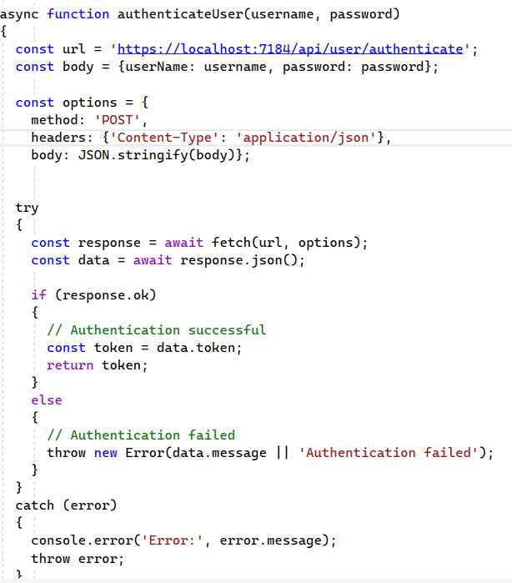
Consuming secured api
Replace index.cshtml (resources)
In the javascript first an API call is made to authenticate the user and receive a JWT

Slide 37
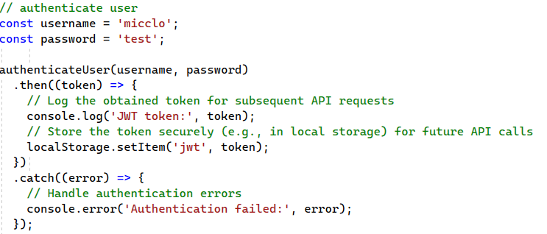
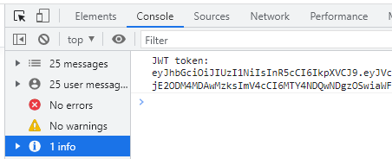
Consuming the secured api in Shop.web project
API call is made to authenticate the user and receive a JWT
JWT is stored in local storage
1
2

Slide 38
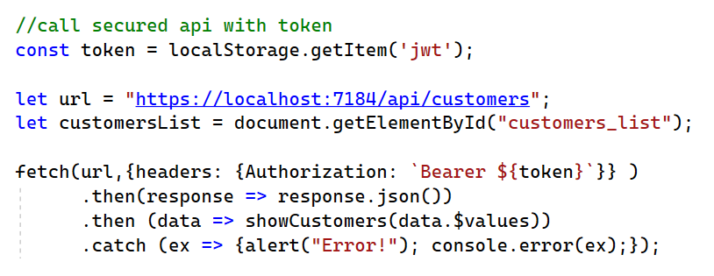
Consuming the secured api in Shop.web project
For each subsequent API request, you need to include the stored JWT in the request headers
3
Notes:
``: backticks needed for templated string `Bearer ${Token}`

